Slide 1
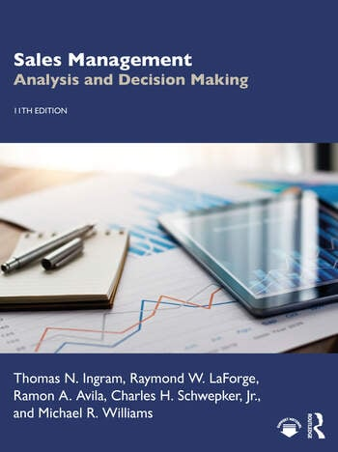
Chapter 9
Evaluating the Effectiveness of the Organization

Slide 2
Learning Objectives
Differentiate between sales organization effectiveness and salesperson performance.
Define a sales organization audit and discuss how it should be conducted.
Describe how to perform different methods of sales analyses for different organizational levels and types of sales.
Describe how to perform a cost analysis for a sales organization.

Slide 3
Learning Objectives
Describe how to perform an income statement analysis, activity-based costing, and return on assets managed to assess sales organization profitability.
Describe how to perform a productivity analysis for a sales organization.
Define benchmarking and Six Sigma and discuss how each should be conducted.

Slide 4
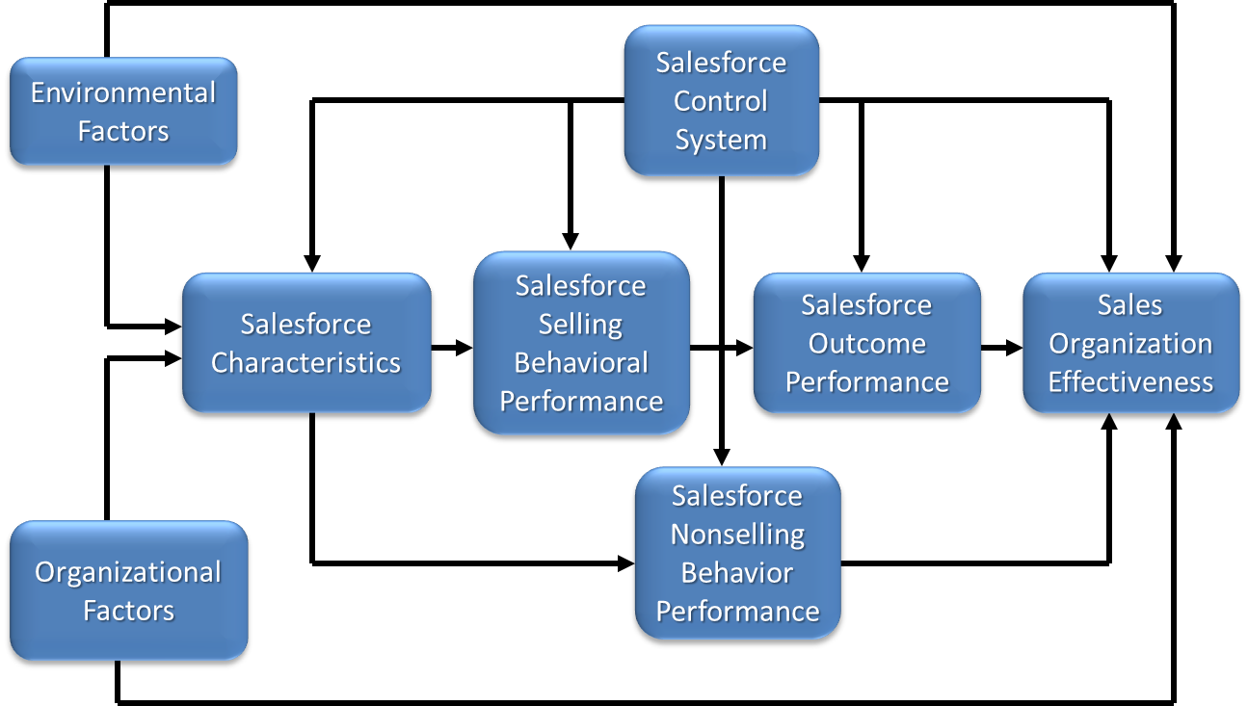
Sales Organization Effectiveness
Notes:
Assessing the success of a sales organization is difficult because so many factors must be considered. For example, the success of the sales organization must be differentiated from the success of individual salespeople (see Figure above).
Whereas sales organization effectiveness is a function of how well the sales organization achieved its goals and objectives overall, salesperson performance is a function of how well each salesperson performed in his or her particular situation. Thus, salesperson performance contributes to, but does not completely determine, sales organization effectiveness.
The focus of the sales organization evaluation is on the overall sales organization—including management levels which comprise the sales organization: districts, regions, territories, and even sales teams.

Slide 5

Sales Organization Audit
Comprehensive, systematic, diagnostic and prescriptive tool.
Assesses the firm’s sales management process.
Provides direction for improved performance and prescription for needed changes.
Should be performed regularly.
Should be conducted by someone from outside the sales organization, but salespeople should be active participants
Notes:
3
The purpose of a sales organization audit is to assess the adequacy of a firm’s sales management process and to provide direction for improved performance and prescription for needed changes. It is a tool that should be used by all firms whether or not they are achieving their goals.

Slide 6
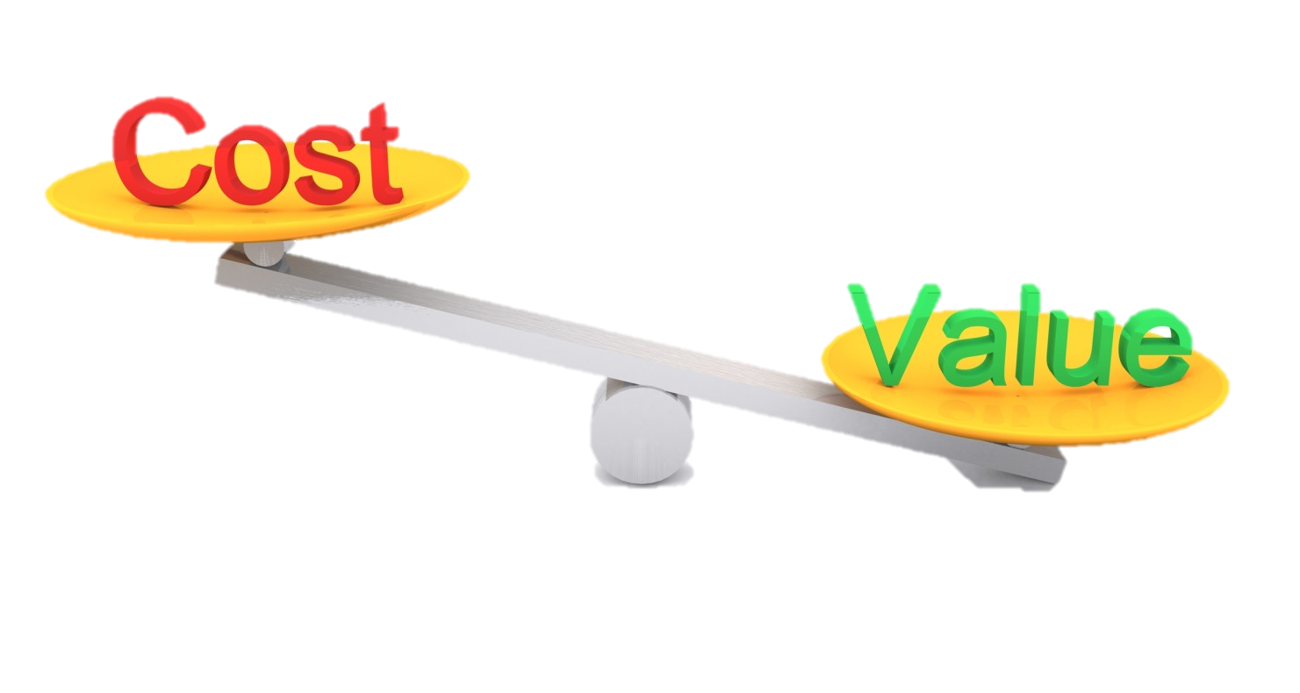
Sales Organization Audit
Although it is an expensive and time-consuming process, the sales organization audit generates benefits that usually outweigh the costs.
Ultimately want higher productivity (among other things):
higher sales per salesperson, and
lower selling expenses as a percentage of sales.
Notes:
3
For example, the more effective sales organizations generated much higher sales per salesperson ($3,988,000 versus $1,755,000) and much lower selling expenses as a percentage of sales (13 percent versus 18 percent) than the less effective sales organizations. The salespeople in the more effective organizations also outperformed salespeople in the less effective ones in several areas. However, the differences in salesperson performance were not sufficient to completely explain the differences in sales organization effectiveness. Thus, sales organization effectiveness is the result of salesperson performance as well as many other factors (e.g., sales organization structure and deployment and sales management performance).

Slide 7
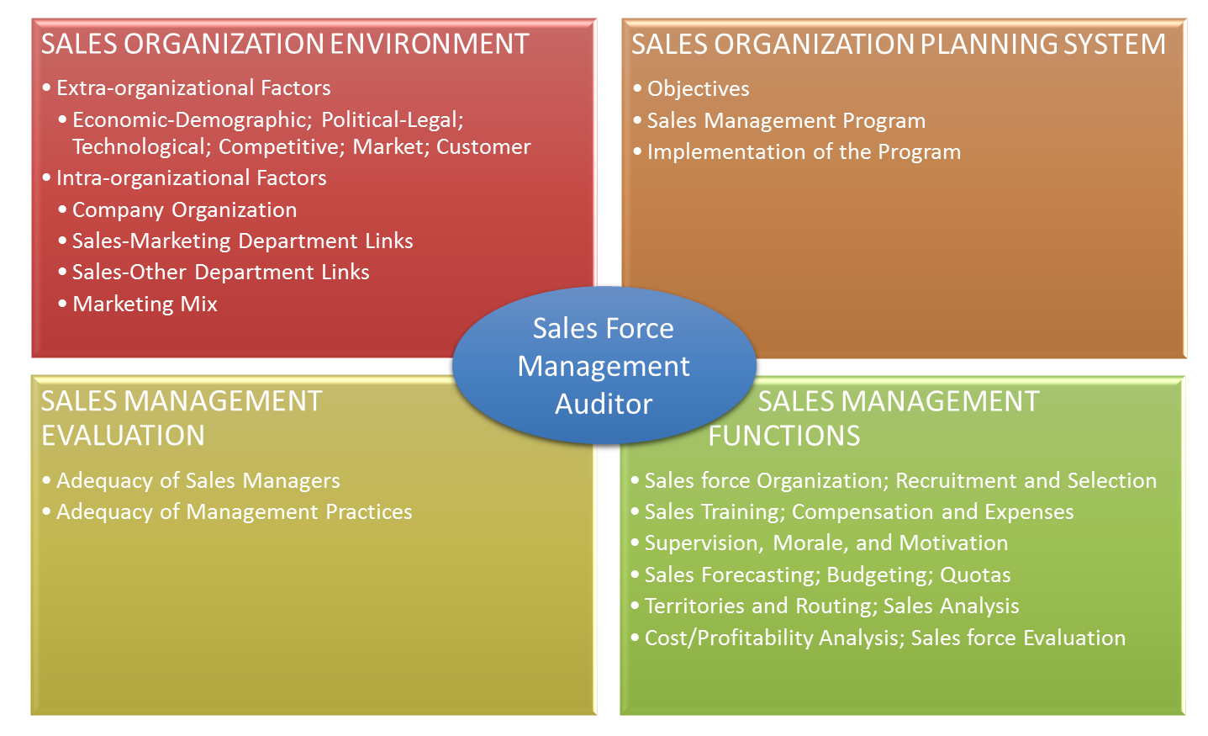
Sales Organization Audit Framework
Salesforce
Management
Auditor
Salesforce Organization; Recruitment and Selection
Notes:
4
As indicated in the figure, the audit addresses four major areas: sales organization environment, sales management evaluation, sales organization planning system, and sales management functions. The purpose of the audit is to investigate, systematically and comprehensively, each of these areas to identify existing or potential problems, determine their causes, and take the necessary corrective actions. For example, after having an agency conduct an audit, Guinness was able to redesign its salesforce to improve its structure and clarity. This resulted in a more motivated, focused, efficient, and subsequently higher-performing sales organization.

Slide 8


Evaluating Effectiveness through Customer Satisfaction Surveys
3:19
Notes:
While many sales organizations focus on sales analysis, evaluation of the customer experience (CX) is rapidly becoming a valuable indicator of sales organization effectiveness. This involves acquiring and analyzing data that covers the full spectrum of CX including customer satisfaction, customer loyalty/retention/churn, customer advocacy/reputation, quality, and employee engagement.

Slide 9
Sales Organization Effectiveness Evaluations
Multiple factors must be assessed.
Four types of analyses
Sales
Cost
Profitability
Productivity
Conducting an analysis in each of these areas is a complex task.
Notes:
5

Slide 10
Sales Organization Effectiveness Framework
Sales Analysis
Profitability Analysis
Sales Organization Effectiveness
Cost Analysis
Productivity Analysis
Notes:
5
Conducting analyses in each of these areas is a complex task for two reasons. First, many types of analyses can be performed to evaluate sales, cost, profitability, and productivity results. For example, a sales analysis might focus on total sales, sales of specific products, sales to specific customers, or other types of sales and might include sales comparisons to sales quotas, to previous periods, to sales of competitors, or other types of analyses. Second, separate sales analyses need to be performed for the different levels in the sales organization. Thus, a typical evaluation would include separate sales analyses for sales zones, regions, districts, and territories.

Slide 11
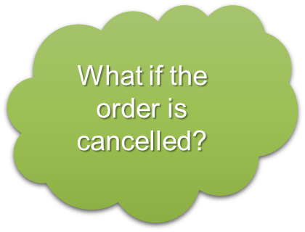
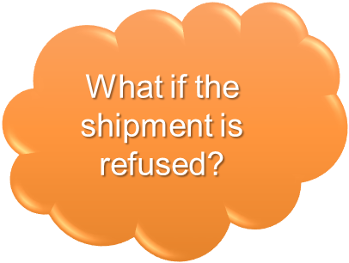
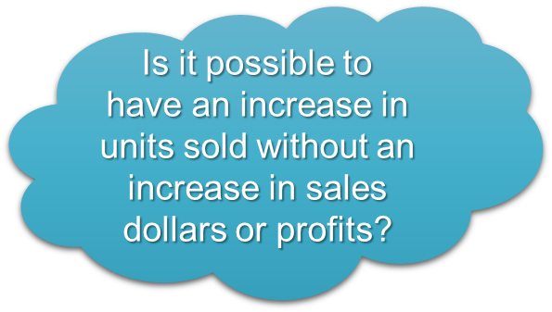
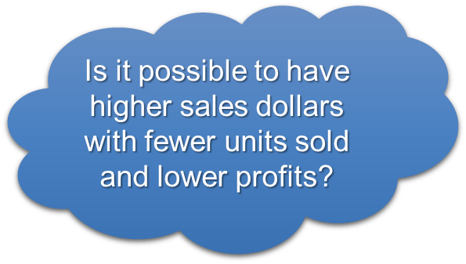
Sales Analysis
When should we count an order as a sale?
When an order is placed?
When an order is shipped?
When payment is received?
What is the primary metric?
Dollars (watch out: improvement from price increases)
Units
Notes:
9
Note: This slide is constructed with layers. It won’t print correctly, but it will play correctly in a slideshow.
Because the basic purpose of a sales organization is to generate sales, sales analysis is an obvious and important element of evaluating sales organization effectiveness. The difficulty, however, is in determining exactly what should be analyzed. One key consideration is in defining what is meant by a sale. Definitions include a placed order, a shipped order, and a paid order. Defining a sale by when an order is shipped is probably most common. Regardless of the definition used, the sales organization must be consistent and develop an information system to track sales based on whatever sales definition is used.
Another consideration is whether to focus on sales dollars or sales units. This can be extremely important during times when prices increase or when salespeople have substantial latitude in negotiating selling prices.

Slide 12
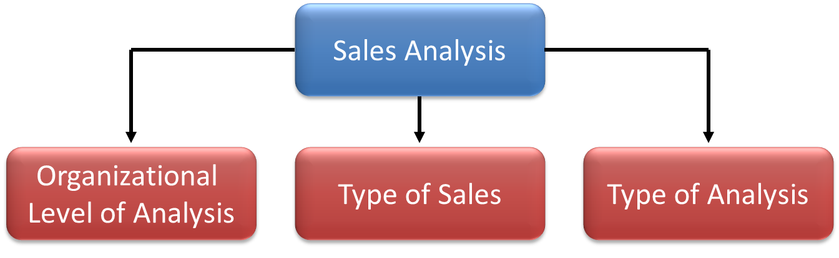
Sales Analysis Framework
Method of Analysis
Notes:
10

Slide 13
Organization Level of Analysis
Method of Analysis
Zones
Regions
Districts
Territories
Accounts
Notes:
10

Slide 14
Example of Hierarchical Sales Analysis
Sales
Organization
Region 1
Region 2
Region 3
Region 4
Sales
$62,000,000
$62,000,000
$56,000,000
$73,000,000
District 1
District 2
District 3
District 4
District 5
Sales
$11,000,000
$12,000,000
$13,500,000
$7,000,000
$12,500,000
Territory 1
Territory 2
Territory 3
Territory 4
Territory 5
Territory 6
Sales
$1,100,000
$1,300,000
$1,250,000
$1,400,000
$750,000
$1,200,000
Additional
Analysis
Notes:
11
Sales analyses should be performed for all levels in the sales organization for two basic reasons. First, sales managers at each level need sales analyses at their level and the next level below for evaluation and control purposes. For example, a regional sales manager should have sales analyses for all regions as well as for all districts within his or her region. This makes it possible to assess the sales effectiveness of the region and to determine the sales contribution of each district.
Second, a useful way to identify problem areas in achieving sales effectiveness is to perform a hierarchical sales analysis, which consists of evaluating sales results
throughout the sales organization from a top-down perspective. Essentially, the analysis begins with total sales for the sales organization and proceeds through each successively lower level in the sales organization. The emphasis is on identifying potential problem areas at each level and then using analyses at lower levels to pinpoint the specific problems.
In the present example, region 3 has the lowest sales, so all districts in region 3 are examined. District 4 has poor sales results, so all the territories in district 4 are examined. Additional analysis is indicated for territory 5.

Slide 15
Type of Sales
Method of Analysis
Type of Product
Type of Account
Type of Distribution
Order Size
Notes:
10

Slide 16
Example of Type-of-Sales Analysis
Territory 5
Product
Type Sales
Account
Type Sales
Product
Type A
Product
Type B
Product
Type C
Account
Type A
Account
Type B
Account
Type C
Sales
$175,000
$275,000
$300,000
$290,000
$175,000
$285,000
Additional Analysis
Additional Analysis
Notes:
11
This example suggests especially low sales volume for product type A and account type B. Additional analyses within these product and account types would be needed to determine why sales are low in these areas and what needs to be done to improve sales effectiveness.

Slide 17
Method of Analysis
Method of Analysis
Comparisons with sales quotas (i.e., effectiveness index)
Comparisons with previous period (i.e., sales growth)
Comparisons within industry/competitors (i.e., market share)
Notes:
10
Comparing actual sales results with sales forecasts and quotas is extremely revealing. A sales forecast represents an expected level of firm sales for defined products, markets, and time periods and for a specified strategy. Based on this definition, a sales forecast provides a basis for establishing specific sales quotas and reasonable sales objectives for a territory, district, region, or zone.

Slide 18
Method of Analysis Examples
District 1
District 2
District 3
District 4
District 5
Sales
$11,000,000
$12,000,000
$13,000,000
$7,000,000
$12,000,000
Sales Quota
$11,250,000
$11,500,000
$12,750,000
$10,000,000
$11,000,000
Effectiveness
Index
98
104
102
70
109
Sales Last Year
$10,700,000
$11,000,000
$12,250,000
$6,800,000
$10,350,000
Sales Growth (IYA)
3%
9%
6%
3%
16%
Industry Sales
$42,000,000
$42,000,000
$45,000,000
$40,000,000
$45,000,000
Market Share
26%
29%
29%
18%
27%
“Effectiveness Index”:
Divide actual sales results by the sales quota and multiply by 100
Notes:
13
An effectiveness index can be computed by dividing actual sales results by the sales quota and multiplying by 100. As illustrated in this Exhibit, sales results in excess of quota will have index values greater than 100, and results lower than quota will have index values less than 100. The sales effectiveness index makes it easy to compare directly the sales effectiveness of different organizational levels and different types of sales.
Another type of analysis to be considered is a comparison of actual sales results to those achieved by competitors (i.e., market share). This type of analysis can again be performed at different organizational levels and for different types of sales. If the comparison is extended to overall industry sales, various types of market share can be calculated.

Slide 19

Cost Analysis
Assess the costs incurred by the sales organization to generate the achieved levels of sales.
Compare the costs incurred with planned budget.
Corporate resources earmarked for personal selling expenses for a designated period represent the total selling budget.
Notes:
9

Slide 20
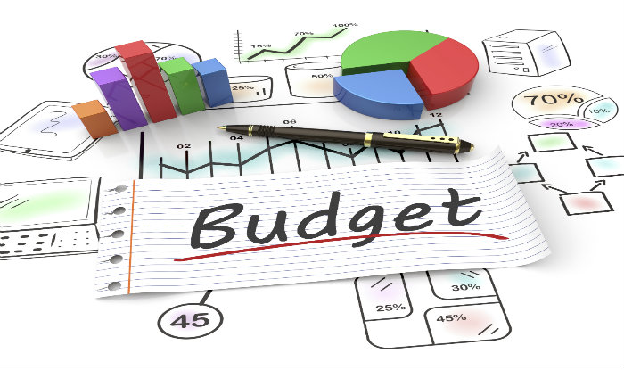
Selling Budgets
Developed at all levels of the sales organization and for all key expenditure categories.
Objective is to determine the lowest expenditure level necessary to achieve sales quotas.
Two approaches to setting the selling budget:
Percentage of sales method
Objective and task method (or zero-based budgeting)
Notes:
9
The emphasis here is on assessing the costs incurred by the sales organization to generate the achieved levels of sales. The general approach is to compare the costs incurred with planned costs as defined by selling budgets.
Corporate resources earmarked for personal selling expenses for a designated period represent the total selling budget. The key sales management budgeting task is to determine the best way to allocate these sales resources throughout the sales organization and across the different selling activities. The budgeting process is intended to instill cost consciousness and profit awareness throughout the organization, and it is necessary for establishing benchmarks for evaluating selling costs.
Selling budgets are developed at all levels of the sales organization and for all key expenditure categories. Our discussion focuses on the major selling expense categories and methods for establishing specific expenditure levels within the budget.
Firms differ considerably in how they define their selling expense categories. Nevertheless, all sales organizations should plan expenditures carefully for the major selling and sales management activities and for the different levels in the sales organization structure. The selling budget addresses controllable expenses, not uncontrollable ones.

Slide 21

Determining Budget Expenditure Level
Percentage of Sales Method
Objective and Task Method
Expenditure percent x forecasted sales
Need reliable forecast
Need accurate expenditure percent
State objectives
Identify tasks necessary to achieve objectives
Estimate cost of tasks
Notes:
Selling budgets are developed at all levels of the sales organization and for all key expenditure categories. We’ll focus on the major selling expense categories and methods for establishing specific expenditure levels within the budget.
Firms differ considerably in how they define their selling expense categories. Nevertheless, all sales organizations should plan expenditures carefully for the major selling and sales management activities and for the different levels in the sales organization structure. The selling budget addresses controllable expenses, not uncontrollable ones.
Probably the most often used, the percentage of sales method calculates an expenditure level for each category by multiplying an expenditure percentage times forecasted sales. The effectiveness of the percentage of sales method depends on the accuracy of sales forecasts and the appropriateness of the expenditure percentages. If the sales forecasts are not accurate, the selling budgets will be incorrect, regardless of the expenditure percentages used. If sales forecasts are accurate, the key is determining the expenditure percentages. This percentage may be derived from historical spending patterns or industry averages. Sales management should adjust the percentage up or down to reflect the unique aspects of their sales organization.
The objective and task method takes an entirely different approach. In its most basic form, it is a type of zero-based budgeting. In essence, each sales manager prepares a separate budget request that stipulates the objectives to be achieved, the tasks required to achieve these objectives, and the costs associated with performing the necessary tasks. These requests are reviewed, and, through an iterative process, selling budgets are approved. Many variations of the objective and task method are used by different sales organizations.

Slide 22
Selling Expense Categories
Original Budget 2024
Actual 2023
Q2 Revision
Q3 Revision
Q4
Revision
Classification
Compensation expenses
Salaries
Commissions
Bonuses
Total
Travel expenses
Lodging
Food
Transportation
Miscellaneous
Total
Administrative expenses
Recruiting
Training
Meetings
Sales offices
Total
Notes:
15
The emphasis here is on assessing the costs incurred by the sales organization to generate the achieved levels of sales. The general approach is to compare the costs incurred with planned costs as defined by selling budgets.
Corporate resources earmarked for personal selling expenses for a designated period represent the total selling budget. The key sales management budgeting task is to determine the best way to allocate these sales resources throughout the sales organization and across the different selling activities. The budgeting process is intended to instill cost consciousness and profit awareness throughout the organization, and it is necessary for establishing benchmarks for evaluating selling costs.
Selling budgets are developed at all levels of the sales organization and for all key expenditure categories. Our discussion focuses on the major selling expense categories and methods for establishing specific expenditure levels within the budget.
Firms differ considerably in how they define their selling expense categories. Nevertheless, all sales organizations should plan expenditures carefully for the major selling and sales management activities and for the different levels in the sales organization structure. The selling budget addresses controllable expenses, not uncontrollable ones.

Slide 23
Cost Analysis Example
Compensation Costs
Training Costs
Actual
Budget
Variance
Actual
Budget
Variance
Region 1
Region 2
Region 3
Region 4
$3,660,000
$3,500,000
$3,150,000
$4,200,000
$3,600,000
$3,700,000
$3,400,000
$3,900,000
$60,000
($200,000)
($250,000)
$300,000
$985,000
$2,110,000
$830,000
$2,340,000
$1,030,000
$2,040,000
$1,060,000
$2,160,000
($45,000)
$70,000
($230,000)
$180,000
Actual % Sales
Budgeted % Sales
Actual % Sales
Budgeted % Sales
Region 1
Region 2
Region 3
Region 4
6.1
5.8
5.4
6.0
6.0
6.0
6.0
6.0
2.9
3.1
2.6
3.1
3.0
3.0
3.0
3.0
Notes:
15
The first analysis calculates the variance between actual costs and budgeted costs for the regions in a sales organization. Regions with the largest variation, especially when actual costs far exceed budgeted costs, should be highlighted for further analysis. Large variations are not necessarily bad, but the reasons for the variations should be determined. For example, the ultimate purpose of selling costs is to generate sales. Therefore, the objective is not necessarily to minimize selling costs, but to ensure that a specified relationship between sales and selling costs is maintained.

Slide 24
An Ethical Dilemma
AKKO Industrial Tools has just announced the company’s new sales performance incentive program for the coming year. As designed, this program will offer opportunities for significant monetary bonuses to each of the company’s 12 regional sales organizations based on the percentage by which each individual region’s actual sales revenues exceed their budgeted revenues for the year. Cailen Wade, sales manager for the Southwest Region, is highly competitive and determined that her region will win the contest. Due to substantial increases in the number of large commercial construction projects planned and announced for several metropolitan areas in the Southwest Region, Cailen’s sales team has potential for exceptional growth in the coming year. However, Cailen and her team are considering a plan to better assure their region wins the incentive bonus. Their plan is to establish a sales budget for the next year that understates the forecasted sales in a way that will make the region’s year-end sales performance look substantially better than budgeted and thus provide the Southwest Region team with a stronger chance of winning the incentive contest. What should Cailen do?
Continue with the plan to establish a sales budget for the next year that understates forecasted sales in a way that will make her region’s performance look substantially better.
Establish a sales budget based on an acceptable increase over the preceding year, but one that does not unrealistically count the planned increases in construction announced for the region.
Establish a sales budget based on the total expected sales that each of her salespeople forecasts for their individual territories.
Another option not mentioned here.

Slide 25

Profitability Analysis
Analyzing the profitability of different organizational levels of different types of sales.
Income Statement Analysis
Activity-Based Costing
Return on Assets Managed
Notes:
16
Start Day 2 Here:
Sales and cost data can be combined in various ways to produce evaluations of sales organization profitability for different organizational levels of different types of sales.

Slide 26

Profitability Analysis: Income Statement Analysis
Full Cost Approach: Allocate shared costs to individual units based on some type of cost allocation procedure.
Contribution Approach: Include only direct costs in the profitability analysis; indirect or shared costs are not included.
Notes:
16
The different levels in a sales organization and different types of sales can be considered as separate businesses. Consequently, income statements can be developed for profitability analysis. One of the major difficulties in income statement analysis is that some costs are shared between organizational levels or sales types.
The full cost approach attempts to allocate the shared costs to individual units based on some type of cost allocation procedure. This results in a net profit figure for each unit.
The contribution approach is different in that only direct costs are included in the profitability analysis; the indirect or shared costs are not included. The net contribution calculated from this approach represents the profit contribution of the unit being analyzed. This profit contribution must be sufficient to cover indirect costs and other overhead and to provide the net profit for the firm.

Slide 27
Profitability Analysis Example
Full Cost
Approach
Contribution Approach
Region
District 1
District 2
District 3
Sales
$300,000,000
$180,000,000
$70,000,000
$50,000,000
Cost of Goods Sold
$255,000,000
$168,500,000
$58,500,000
$28,000,000
Gross Margin
$ 45,000,000
$ 11,500,000
$11,500,000
$22,000,000
District Selling Expenses
$ 11,000,000
$ 5,000,000
$ 3,500,000
$ 8,250,000
Regional Direct Selling Expenses
$ 10,000,000
---
---
---
Profit Contribution
$ 24,000,000
$ 6,500,000
$ 8,000,000
$19,500,000
Allocated Portion of Shared Zone Costs
$ 16,000,000
Net Profit
$ 8,000,000
***Trend is toward the contribution approach (only direct costs) probably because
of the difficulty in arriving at a good procedure for allocating the shared costs
Notes:
18
This example uses the full cost approach for assessing sales region profitability and the contribution approach for evaluating the districts within this region. Notice that the profitability calculations for each district include only district sales, cost of goods sold, and district direct selling expenses. A profit contribution is generated for each district. The profitability calculations for the region include district selling expenses, region direct selling expenses that have not been allocated to the districts, and an allocated portion of shared zone costs. This produces a net profit figure for a profitability evaluation of the region.
Although either approach might be used, there seems to be a trend toward the contribution approach, probably because of the difficulty in arriving at a satisfactory procedure for allocating the shared costs. Different cost allocation methods produce different results. Thus, many firms feel more comfortable with the contribution approach because it eliminates the need for cost allocation judgments and is viewed as more objective.

Slide 28

Profitability Analysis: Activity-Based Costing (ABC)
Allocates costs to individual units on the basis of how the units actually expend or cause these costs.
Places greater emphasis on more accurately defining unit profitability by tracing activities and their associated costs directly to a specific unit.
Notes:
17
Activity-based costing (ABC) allocates costs to individual units on the basis of how the units actually expend or cause these costs. Costs are accumulated and then allocated to the units by the appropriate drivers, factors that drive costs up or down.

Slide 29
Warm-Up to ABC
Have you ever thought about how much it really costs to serve a customer?
Do all customers cost the same to support?
Scenario:
Customer A places one large order/month online.
Customer B calls five times/week with small, customized orders.
Who is more profitable?
Notes:
Encourage students to think about the differences in serving different types of customers.

Slide 30
What is Activity-Based Costing (ABC)?
ABC assigns costs to activities based on actual resource usage.
Activities consume resources; products/customers consume activities.
Provides more accurate cost info than traditional costing methods.
Notes:
Introduce the definition of ABC and its key principles. Emphasize that it's about linking costs to actual activities rather than spreading them evenly.

Slide 31
Traditional Costing vs. ABC
Traditional Costing:
Spreads overhead using broad averages (e.g., % of sales)
Activity-Based Costing:
Assigns overhead based on actual activities (e.g., orders, calls)
Notes:
Compare and contrast traditional costing and ABC. Give examples, such as using a flat rate for support vs. tracking time per customer.

Slide 32
ABC Example in Sales
Activity Costs:
Order Processing: $10/order
Delivery: $100/delivery
Support: $10/call
Who is more profitable?
Customer A: $350
Customer B: $1,100
Notes:
Walk through the example calculations for Customers A and B. Ask students who they think is more profitable and why.

Slide 33
Key Takeaways
ABC shows true cost to serve customers/products
Helps with pricing, segmentation, process improvements
Sales managers use ABC to identify profit opportunities
Notes:
Summarize the lesson. Reinforce how ABC helps sales managers make smarter decisions about pricing, targeting, and service.

Slide 34
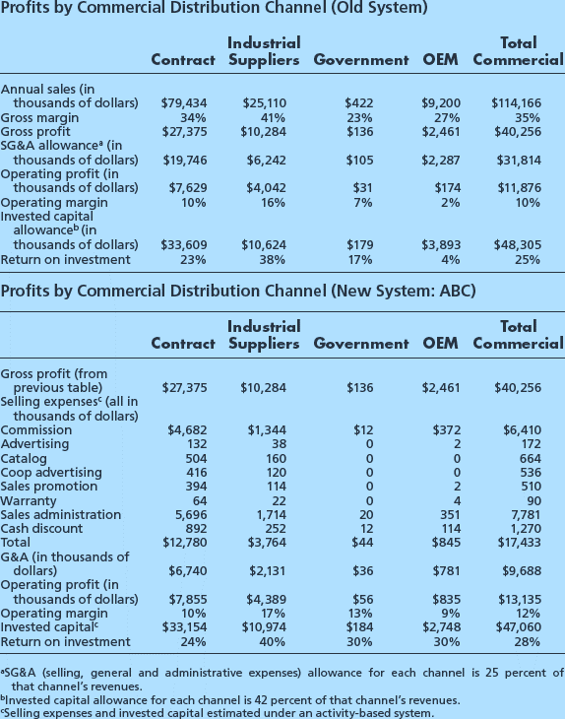
Activity-Based Costing Example
Notes:
This illustrates how the profitability picture changed for a building supplies company that switched to ABC to assess distribution channel profitability. Notice that with ABC, selling expenses are no longer allocated to each channel based on a percentage of that channel’s sales revenues. Instead, costs associated with each activity used to generate sales for a specific channel are allocated to that channel. With ABC, a clearer picture of operating profits per channel emerges. In particular, the original equipment manufacturer channel appears to be much more profitable than the firm’s prior accounting system indicates.
ABC places greater emphasis on more accurately defining unit profitability by tracing activities and their associated costs directly to a specific unit. For example, using ABC analysis, the Doig Corporation was able to lower costs by identifying which tasks added value and which ones did not. For instance, it identified which customers could be served just as well by phone, saving both reps and the company time and money.

Slide 35
Profitability Analysis: Return on Assets Managed Analysis (ROAM)
Calculations provide an assessment of profitability and useful diagnostic information.
ROAM is determined by both profit contribution percentage and asset turnover.
ROAM = Profit contribution as percentage of sales X Asset turnover rate
= (Profit contribution / Sales) X (Sales / Assets managed)
NOTE: The income statement approach is incomplete because it doesn’t
incorporate any evaluation of the investment in assets required to
generate the net profit or profit contribution.
Notes:
17
The income statement approach to profitability assessment produces net profit or profit contribution in dollars or expressed as a percentage of sales. Although necessary and valuable, the income statement approach is incomplete because it does not incorporate any evaluation of the investment in assets required to generate the net profit or profit contribution.
The calculation of return on assets managed (ROAM) can extend the income statement analysis to include asset investment considerations.

Slide 36
Return on Assets Managed (ROAM)
District 1
District 2
District 3
District 4
Sales
$24,000,000
$24,000,000
$24,000,000
$24,000,000
Cost of Goods Sold
12,000,000
12,000,000
14,000,000
14,000,000
Gross Margin
12,000,000
12,000,000
10,000,000
10,000,000
District Selling Expenses
7,200,000
9,600,000
5,200,000
8,800,000
Profit Contribution
4,800,000
2,400,000
4,800,000
1,200,000
Accounts Receivable
8,000,000
4,000,000
16,000,000
4,000,000
Inventory
8,000,000
4,000,000
16,000,000
4,000,000
Total Assets Managed
16,000,000
8,000,000
32,000,000
8,000,000
Profit Contribution Percentage
20%
10%
20%
5%
Asset Turnover
1.5
3.0
.75
3.0
ROAM
30%
30%
15%
15%
Notes:
18

Slide 37

Productivity Analysis… getting more with less
Compares profits and asset investments.
Expressed in terms of ratios of inputs to output.
Productivity improvements are obtained in one of two basic ways:
Increasing output with the same level of input;
Maintaining the same level of output but using less input.
Notes:
19
Productivity is typically measured in terms of ratios between outputs and inputs.

Slide 38
Productivity Analysis Example
District 1
District 2
District 3
District 4
Sales
$20,000,000
$24,000,000
$20,000,000
$24,000,000
Selling Expenses
2,000,000
2,400,000
3,000,000
3,000,000
Sales Calls
9,000
7,500
8,500
10,000
Proposals
200
180
260
270
Number of Salespeople
20
30
20
30
Sales/Salesperson
$ 1,000,000
$ 800,000
$1,000,000
$ 800,000
Expenses/Salesperson
$ 100,000
$ 80,000
$ 150,000
$ 100,000
Calls/Salesperson
450
250
425
333
Proposals/Salesperson
11
6
13
9
Notes:
20

Slide 39

Benchmarking
Benchmarking is an ongoing measurement and analysis process that compares an organization’s current operating practices with the “best practices” used by world-class organizations.
Notes:
7

Slide 40
Benchmarking Process
Analyze & Communicate
Determine current performance gap.
Project future performance levels.
Communicate benchmark findings and gain acceptance.
Plan
Identify what to benchmark.
Identify comparative companies or salesforces.
Implement & Control to Improve Performance
Establish functional goals.
Develop action plans.
Implement specific action plans and monitor progress.
Recalibrate benchmark.
Gather Data
Determine data collection method and collect data.
Notes:
8

Slide 41

Six Sigma
Data-driven methodology that attempts to eliminate defects in any process.
Six Sigma – 3.4 mistakes per million opportunities.
Improve processes by reducing variation
Credited with saving large companies hundreds of millions of dollars.

Slide 42

Six Sigma in Plain English
4:54

Slide 43
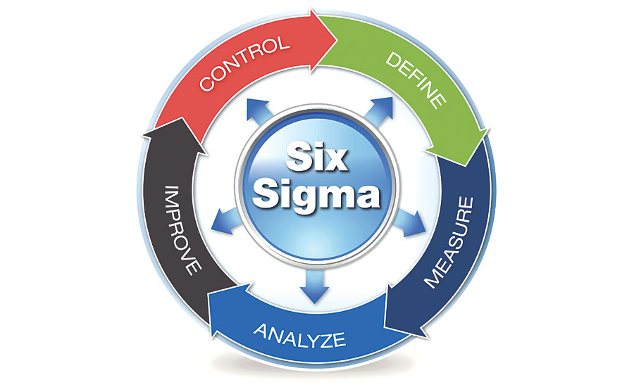
The Steps of Six Sigma
Source: https://www.qualitymag.com

Slide 44
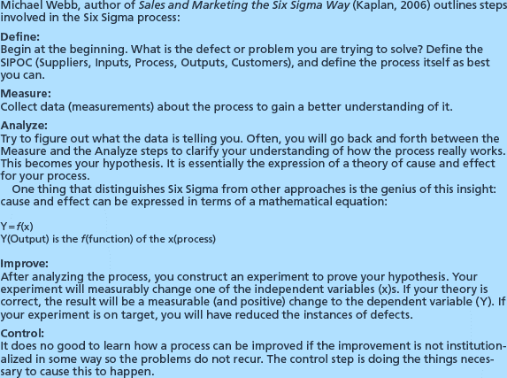
The Steps of Six Sigma

Slide 45
An Ethical Dilemma
A leading supplier of equipment and supplies for research, testing, and medical labs, Isotek Lab Supply has been a longtime proponent of faith-based business principles which directly link to the organization’s founding family. One of the company’s long-standing policies does not allow alcoholic beverages to be used in any of its business activities. This includes marketing conferences and trade shows and even extends to the company’s sales personnel entertaining customers. Gage Sutton, sales manager for the Western Region, is discussing the recent success of salesperson Lucy Waits in acquiring a substantial opening order from a national medical buying group along with monthly commitments over the coming year. During their discussion, Lucy mentions that as the result of several dinner meetings with the buying group’s regional buying team – where the customer’s buying team ordered wine and cocktails with their dinner – she is personally out just over $875 because of the company’s policy. Lucy asks Gage if she could just add some extra mileage, over-and-beyond what she actually travels in the coming month, to her expense report that would add up to what she is out of pocket for the unreimbursed drinks. What should Gage do?
Approve Lucy’s request to overstate her mileage in an amount that would reimburse her for the $875 in wine and cocktails her customers ordered.
Remind Lucy that company policy does not allow alcoholic beverages to be used in any business activities and that overstating her mileage would be an additional violation of company policy that should not be done for any reason. Lucy is simply out the $875.
Recognize this as a special situation that was beyond Lucy’s control and authorize the additional $875 reimbursement for the dinner meetings and discuss strategies with Lucy to assist her from being put in this type of situation in the future.

Slide 46

Ethical Issues
A salesperson has been on the road for a week and incurs laundry expenses. He knows that if he places the laundry expenses under the miscellaneous expense category in his expense report, he will have to provide receipts. He decides that he can include them under the meals category because receipts are not required for this category as long as he stays under his per-diem allowance.
A salesperson is trying to get the customer to purchase a new product. He decides to take three individuals from the customer’s firm to dinner and a basketball game, even though he knows that he has exceeded his entertainment budget for the month. He thinks about hiding these entertainment expenses in different categories in his expense report.

